Slide 1




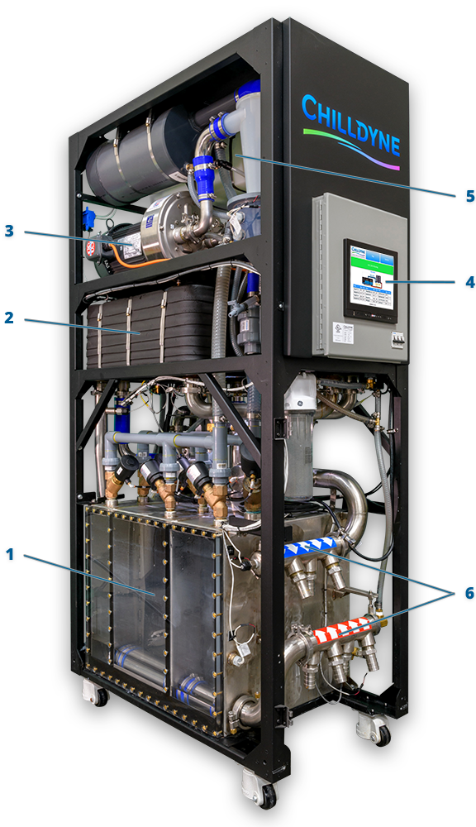

Positive Pressure Solution
Cooling
Server
Negative Pressure Solution
Cooling
Server

Slide 2
MAX Vacuum
Partial Vacuum
MAX Vacuum

Slide 3
CDU300 HMI System
Touch Screen HMI
Industrial board
Stripped down Ubuntu
Chromium Kiosk Mode
Java base program for admin services for Embedded system
Uses the Embedded System’s site as its HMI.
Embedded System
Free RTOS
In C
Server, hosts HMI up to 10 workstations
HMI using HTML, CSS and JavaScript

